Slide 1
ENG4118/5326 - Robotics 4/M Sensors, Actuators and Image capture, processing and analysis
Lecture 9
Kevin Worrall

Slide 2
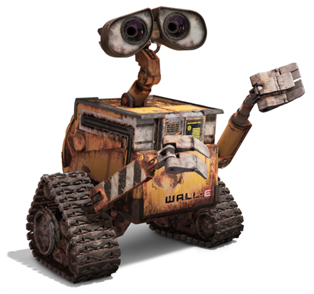
Lecture Overview
More sensors

Slide 3
Visual Sensors
Covered in another section of the course
Image capture
Image processing
Image analysis
And applications
Vision
Stereo Vision
Motion tracking
A lot to take in

Slide 4
Other Sensors
There are many other sensors that we have not yet discussed but are in wide use
Sound and Voice
Compasses
IMU
Motion tracking
GPS
This lecture aims to introduce these concepts

Slide 5
Sound and Voice

Slide 6
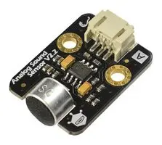
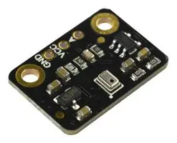
Sound
Sound sensor detects a sound
Sensors converts into an electrical signal
Electrical signal is digitised and can be analysed to interpret the sound wave detected
Sound Sensor
Microphone

Slide 7
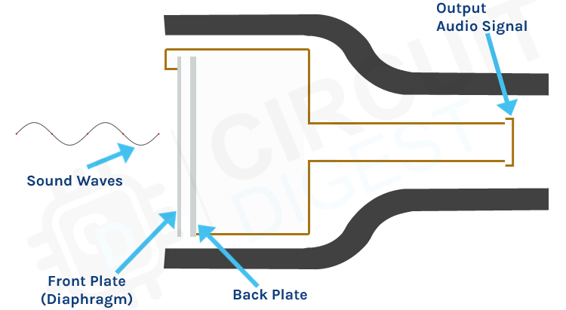
Sound
Different type of microphones
Condenser type is one
Sound waves strike a diaphragm,
This changes the distance to a second fixed plate
Using the capacitive effect an output signal is created
This output can be measured

Slide 8
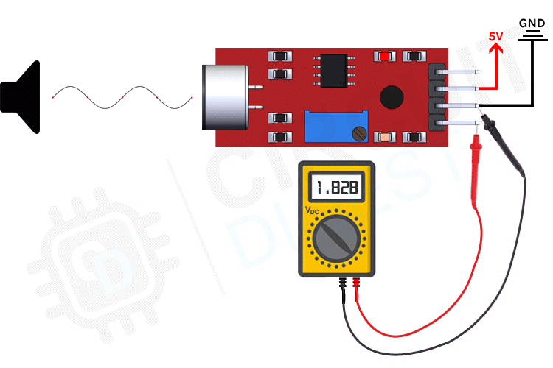
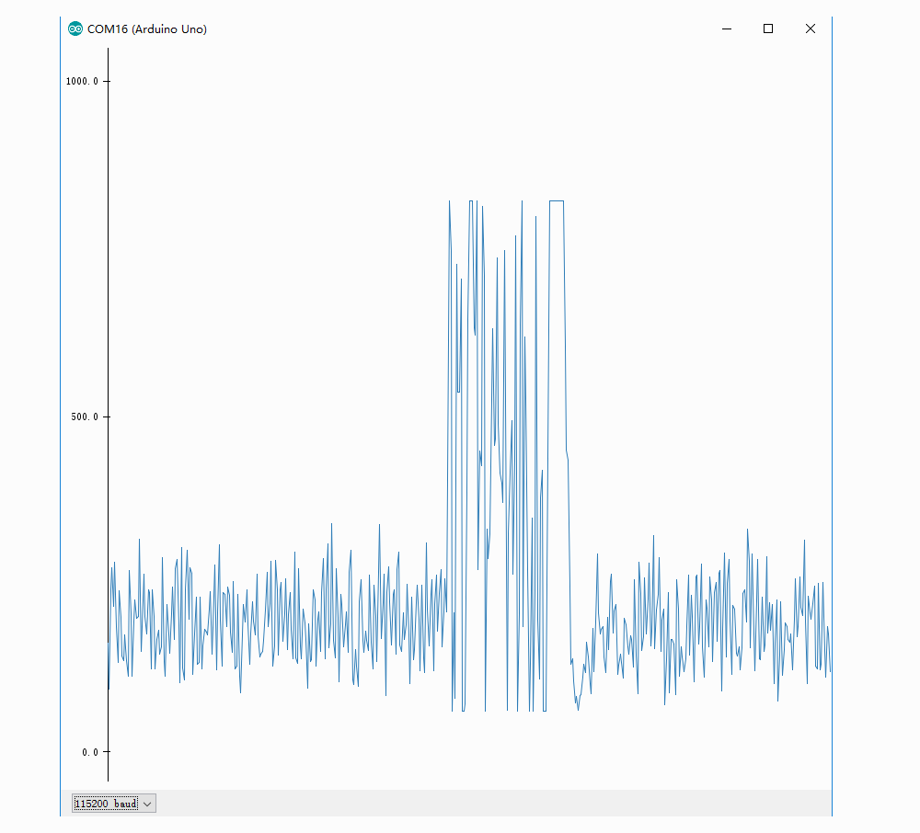
Sound
Interface circuits
Many different types
Some will just return that a sound within a set frequency was heard
Others will pass on the complete range of signals heard – this would need further analysis
Different uses
Detect noise within workspace
Detect commands

Slide 9
Voice Recognition
Involves determining what is said and taking an action based on the perceived information.
Works on the frequency content of spoken words.
Every word is decomposed into its constituent frequencies with a unique signature. Allows the system to recognize the word.
The user must train the system by speaking the words a priori.
Speech recognition
Machine learning algorithms

Slide 10
Voice Recognition
Creates a look-up table of the major frequencies.
Tries to match with the information in the look-up table.
Recognition affected by variations in volume, accent, speed, etc.
More accurate look-up table makes recognition more difficult.
Requires processing power to do this accurately but simple systems can be easily created

Slide 11
Compasses

Slide 12
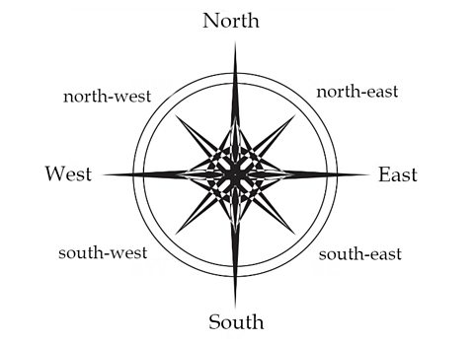
Compasses
Navigational device
Shows direction relative to the Earth’s magnetic field
Can provide a fixed point for reference for a mobile robot or an additional fixed reference point for a manipulator

Slide 13
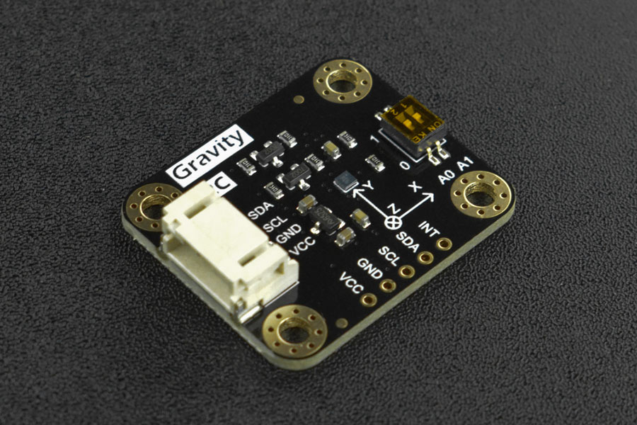
Compasses
For robotics – Magnetometers are usually used
Normally in a triaxial configuration
Can detect the magnetic field about the sensor
Like haff effect sensors but can provide details about the magnetic field
Normally used to detect the strength of a magnetic field
With some coding the number of degrees from North can be calculated – hence the compass
Accelerometers are normally included so the Earths “down” (gravity vector) can be detected
Compensates for tilt etc

Slide 14
Compasses
Main uses
Providing a reference point
heading control for mobile robots
Can be used to measure the angle from a set magnetic field point
External motion control
Be aware of the drawbacks
Other Magnetic fields can alter the measurements
Steel in buildings and surroundings can alter the magnetic field

Slide 15
IMU

Slide 16
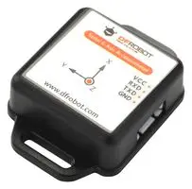
IMU
Inertia Measurement Unit
Made up of
Accelerometers
Rate Gyroscopes
Magnetometers
Various constructs
MEMs based
Allows for digital interfacing and filtering to be done on aboard

Slide 17
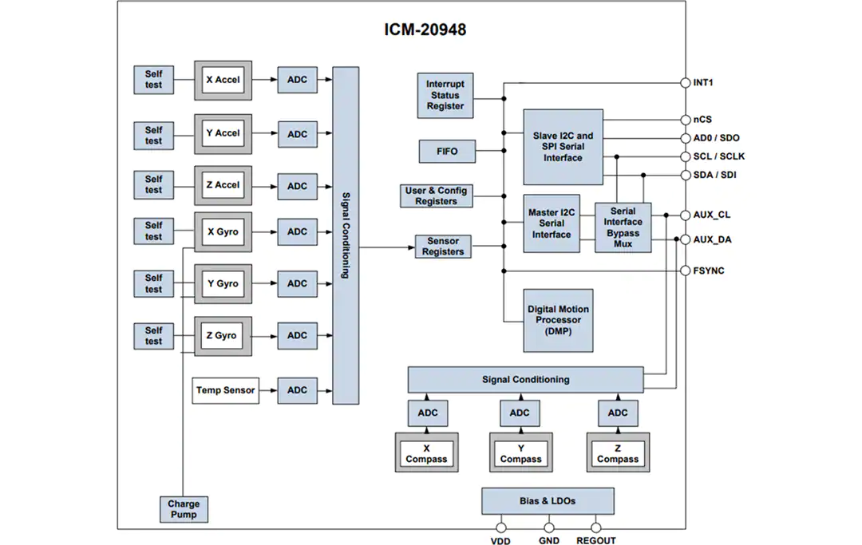
IMU
The theory behind the main components has been covered
IMUs combine more than these though
Temperature sensor
Signal conditioning
External interface
Motion processes
Typically, onboard software
Filtering
Sensor fusion

Slide 18
IMU
But why integrate all these?
Motion of the system can be referenced to this single point
The output of each sensor can compensate for the output of the other sensors
What can the IMU be used for?
In place of the single sensors provided before – providing more information
Motion sensing
AR, VR
Robotics in general

Slide 19
Motion Tracking

Slide 20
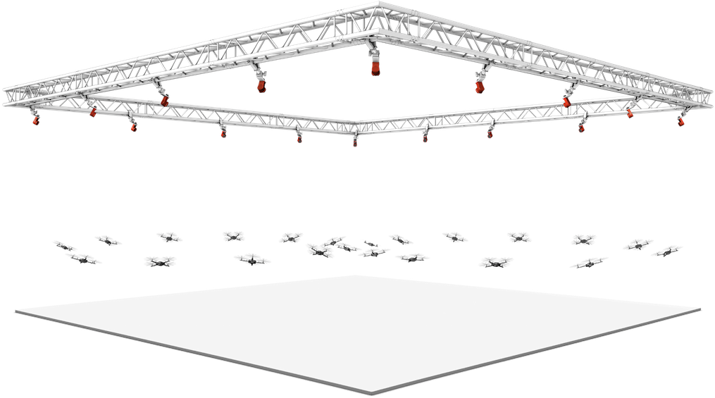
Motion tracking
Sometime internal sensors are not enough or do not provide a full picture of the current operational environment
Need to look at the system AND the environment
Motion tracking is used for this
Films and video games use this as motion capture

Slide 21
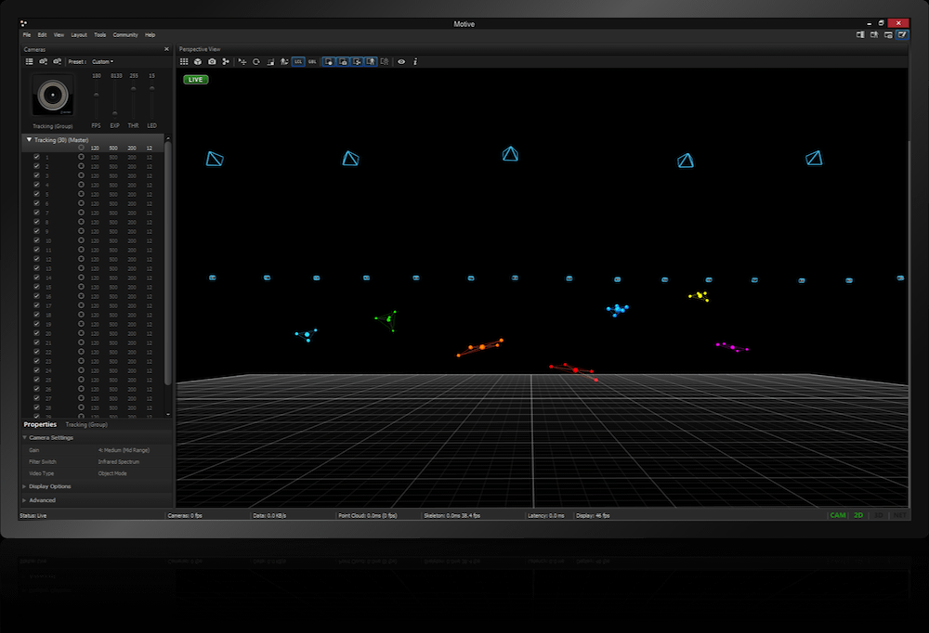
Motion tracking
Many different approaches
Visual,
Infrared,
Magnetic
Markers are normally placed in critical areas of the system
These are tracked by using a series of cameras
Triangulation is then used
Some systems claim μm precision

Slide 22
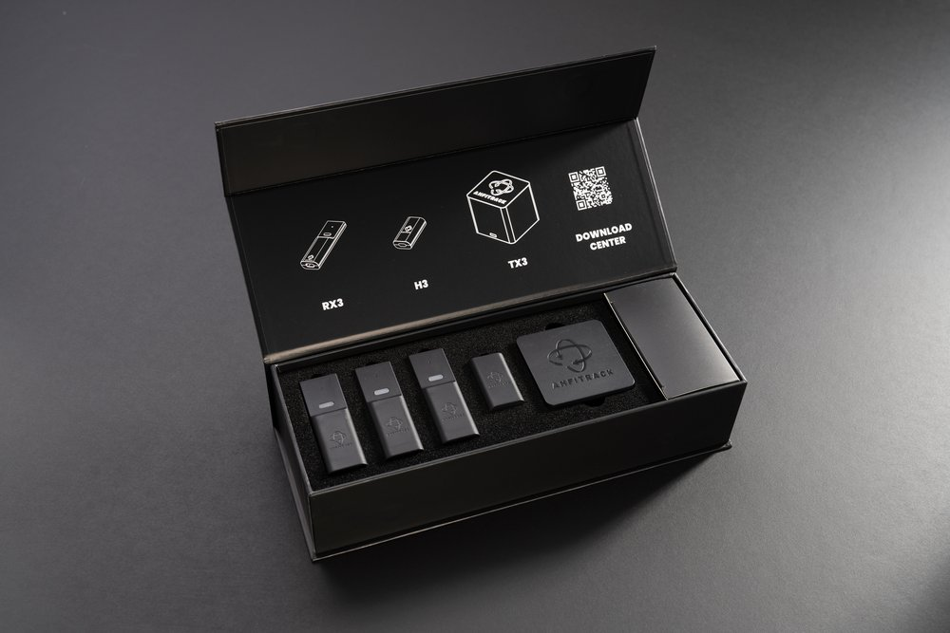
Motion tracking
Magnetic system operates in a similar way
Base station emits emf
Receivers pick this up and reflect the signal back
Triangulation can be used but normally systems are more advanced

Slide 23
Motion tracking
Using motion tracking
Track external the path of a robot
Track a robot manipulator
Allow for planning
Provide external feedback to improve the internal feedback

Slide 24
GPS

Slide 25
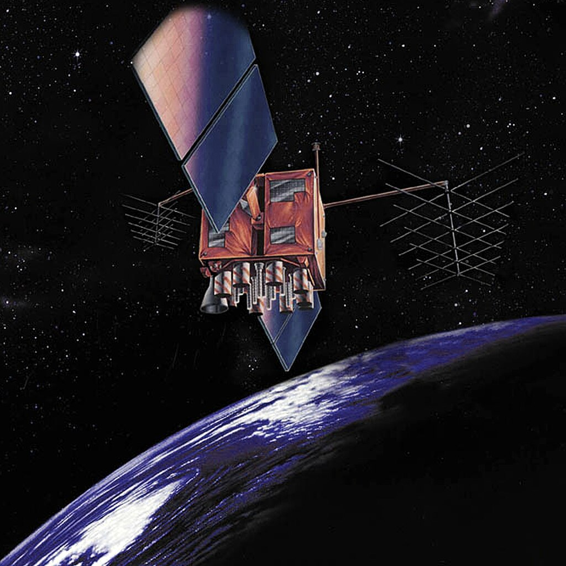
GPS
Used in mobile robots and navigation systems to determine the current position of the device relative to a global reference frame.
The system includes many satellites orbiting the Earth at about 20,000 km, a control and monitoring station on Earth, and the GPS receivers.

Slide 26
GPS
The receiver uses the transmitted data from the satellites to calculate its position. This information can be sent directly to the control system of a mobile robot for positioning purposes and navigation.
Each satellite sends signals at precise intervals with information about the time the signal was sent and location of the satellite.
The GPS unit reads the signals sent by four satellites, and using the difference between the current time and the time at which each signal was sent calculates the distance to the satellite.
Each distance forms a sphere centred at the satellite, on which the GPS unit resides. The intersection between these spheres is the location of the GPS unit.

Slide 27
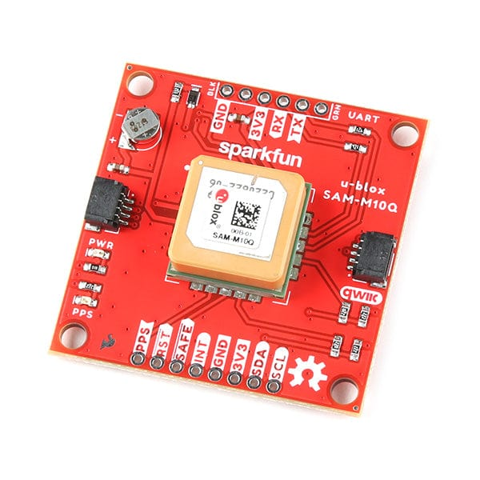
GPS
Can be extremely accurate sub metre
Differential GPS can improve this
Two receivers with a fixed distance between them
Triangulation
Only really for outside
Just ask your phone
Should also be implemented when you can
Can take time to settle and locate satellites
Many off the shelf providers
…oh care needs to be taken with Antenna position

Slide 28
References
Niku, S.B. , Introduction to Robotics, 2nd Edition, Wiley, New Jersey, 2011

